Slide 1
UNIVERSITY OF INVINCIBLES
PROJECT MANAGEMENT ANALYTICS

Slide 2
Requirements from stakeholder
The university of Invincibles has its own static website that is built by peer developers long back and the educational organization has decided to transform that into a dynamic web portal for its students.
The dynamic webpage should have student applications that should allow them to log in and check their pieces of information, view Timetable, Library information, and much more.
The organization needs a viable outcome on every single release concentrating on all student applications one by one integrated with the education website.
The budget allocated for this project is $55000.

Slide 3
Project Planning - Charter
Methodology - Agile Scrum
Project Management tool - Jira Software management
UNIVERSITY OF INVINCIBLES SCRUM BOARD
https://group9project.atlassian.net/jira/software/projects/UOI/boards/3

Slide 4
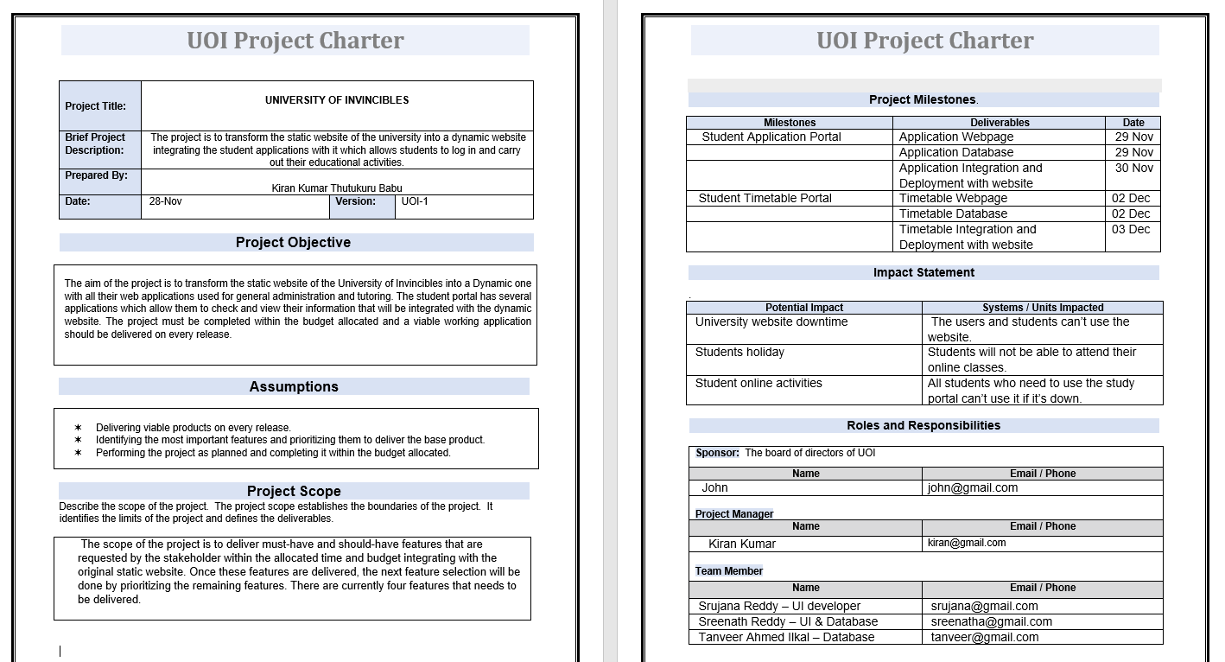
Project Planning - Charter

Slide 5
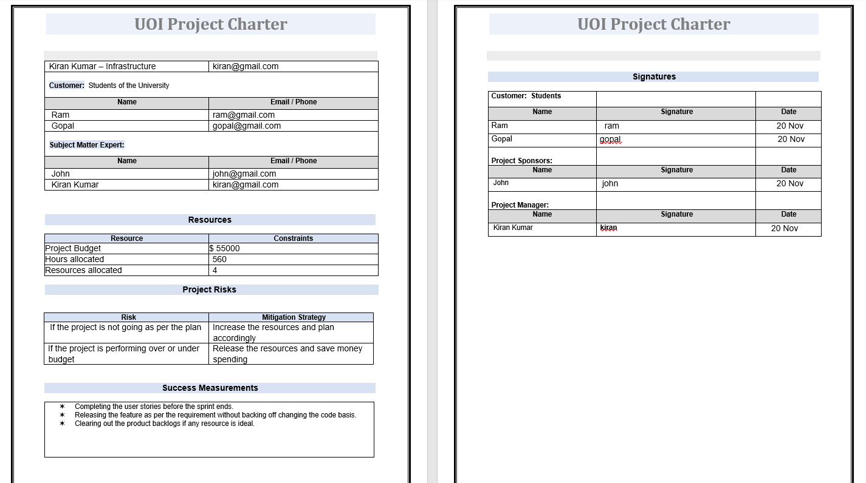
Project Planning - Charter

Slide 6
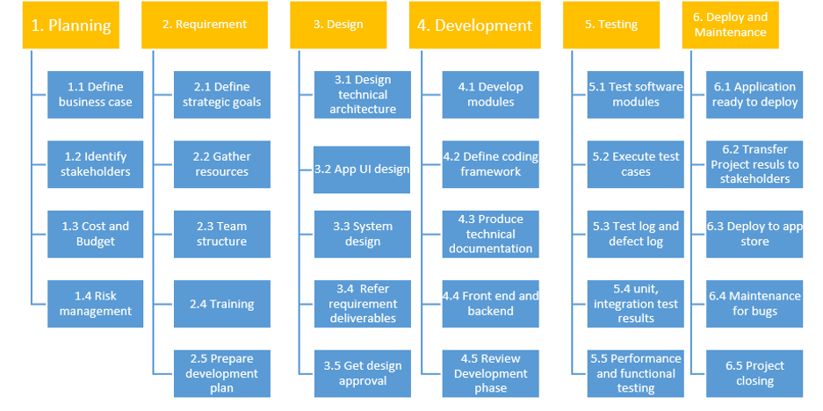
Work Breakdown Structure
UNIVERSITY OF INVINCIBLES

Slide 7
List of Features
Student Application Portal
The objective of this feature is to design a separate webpage for the students to log in and view their personal and course-related information that they have enrolled in university and modify their details
Student Timetable Portal
This feature will allow the students to view their classes scheduled for the given semester along with the courses and their weightage in a separate webpage designed.

Slide 8
List of Features
Student Library Portal
This feature will concentrate on delivering a webpage designed specifically to help the students with the books and academic materials that are available in the university for their usage.
Student Study Portal
This webpage will allow the students to view their grades and assignments and help them to attend the online classes scheduled if any.

Slide 9
Feature Dependency
Feature-2 Feature-4
Feature-1
Feature-3
Student Timetable
Portal
Student Study
Portal
Student Application
Portal
Student Library
Portal

Slide 10
Estimation Techniques and Schedule
Dot voting estimation
Each team member has been given the chance to roughly estimate the story points and asked the reason justifying why they gave. The higher the story points they justified that it consumes higher resources and the vice versa. The story points were given based on the discussion made by the entire team.
Scheduling
Since all the feature's so-called Epics have the same type of development stage that can be done in 3 stages, i.e., UI web development, Database development and a DevOps engineer, Each of the experts from this field were put together to complete this.

Slide 11
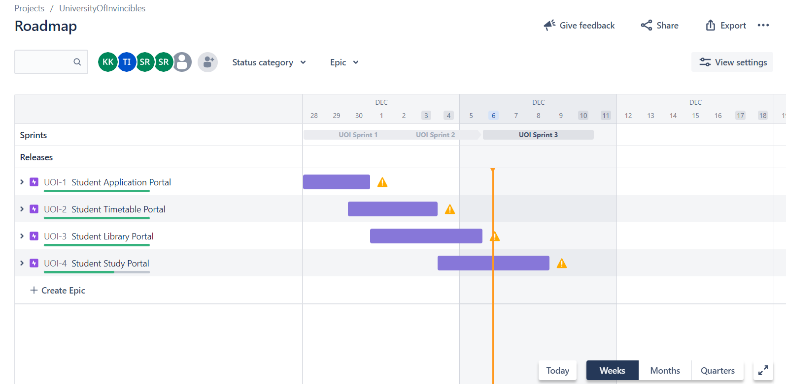
Project Road Map

Slide 12
Project Road Map
Since the features have internal dependency between them, The feature deliveries are planned in the same way.
Timetable Portal and Library Portal can only start after the completion of Application Portal since the student data is needed to login into the application.
In the same way, The Study Portal can only be done when the timetable is done.
Three user stories for each epic/feature has been created and assigned with its Parents epic since there are only 3 development stages for each feature.

Slide 13
Sprint Planning
User Stories were created according to the epics and moved to the Product Backlogs.
The story sprint points were estimated using Dot voting technique of Agile.
User stories that have top priority have been picked up and moved accordingly and have been prioritized to deliver the feature viable product.

Slide 14
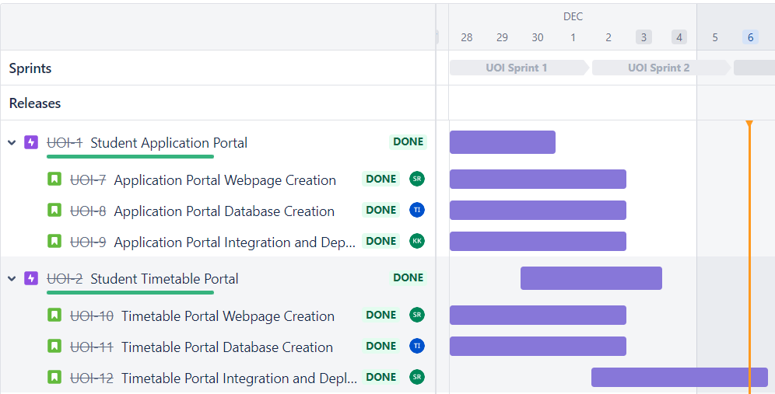
Sprint 1 Dates - Nov 28- Dec 2
As per the features planned from the roadmap, Sprint 1 had 6 user stories for delivering Application and Timetable portals. The total story points for Sprint 1 is 40.
The velocity of the sprint was decided based on the roadmap since there were no previous sprints to consider and evaluate the velocity of the team and plan accordingly.

Slide 15
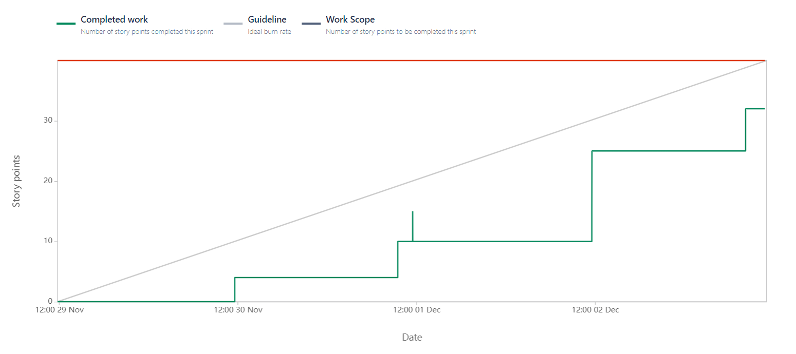
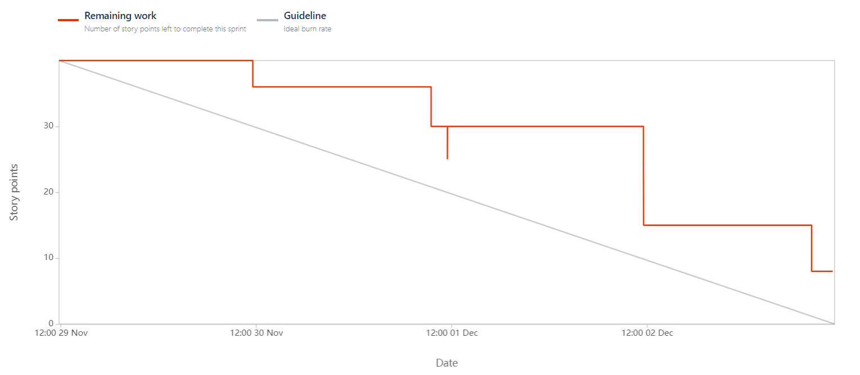
Report Analysis
The Burnup and burndown chart in Sprint 1 depicts
The project is not performing as per the trendline and was lagging. The completed sprint points are always below the trendline and are not going as expected.

Slide 16
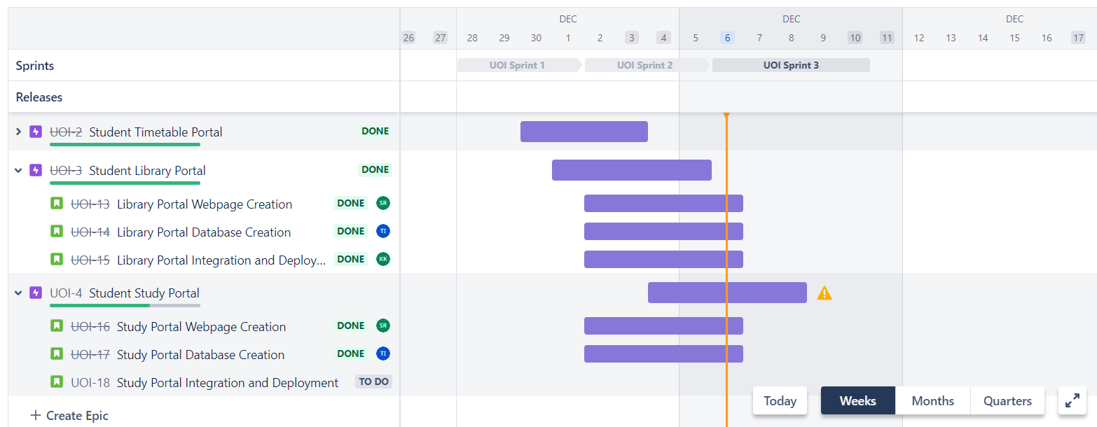
Sprint 2 Dates - Dec 2- Dec 6
As per the features planned from the roadmap, Sprint 2 had 4 user stories for delivering Library and Study portals and 2 more user stories were added as not to keep the resources ideal. The total story points for Sprint 1 is 42.
The velocity of the sprint was decided based on the previous sprint performance of the team as the team was not able to complete the assigned story points, it was limited to 31 and then after completing the 4 user stories in 2 days, 2 more user stories from product backlog was added to the ongoing sprint as the resources can’t be ideal.

Slide 17
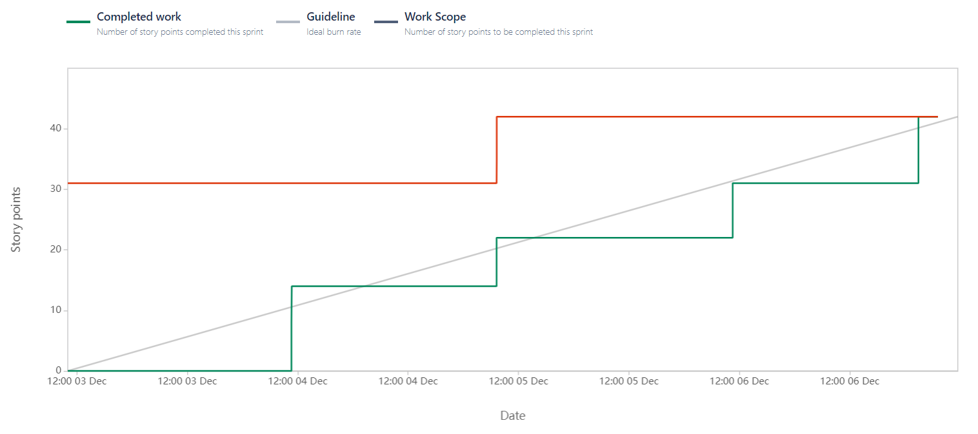
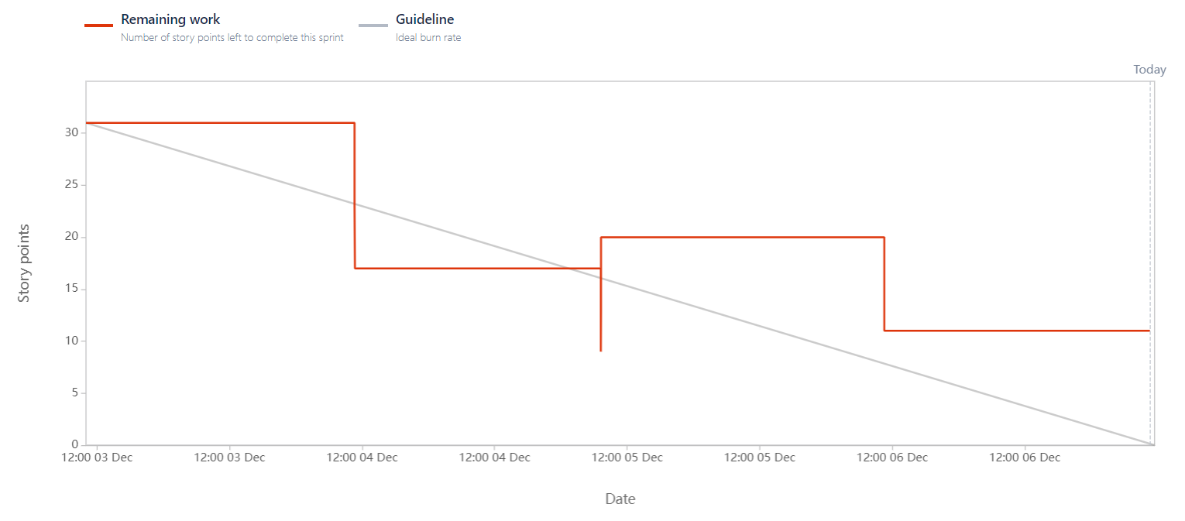
Reports Analysis for Sprint-2
The Burnup and burndown chart in Sprint 2 depicts
The project is performing better than sprint 1 and the graph is above the trendline which means that the project is on track and far away from meeting the deadlines. The glitch in the graph is because of the additional stories that have been added from the product backlog just not to keep the resources ideal without any work.

Slide 18
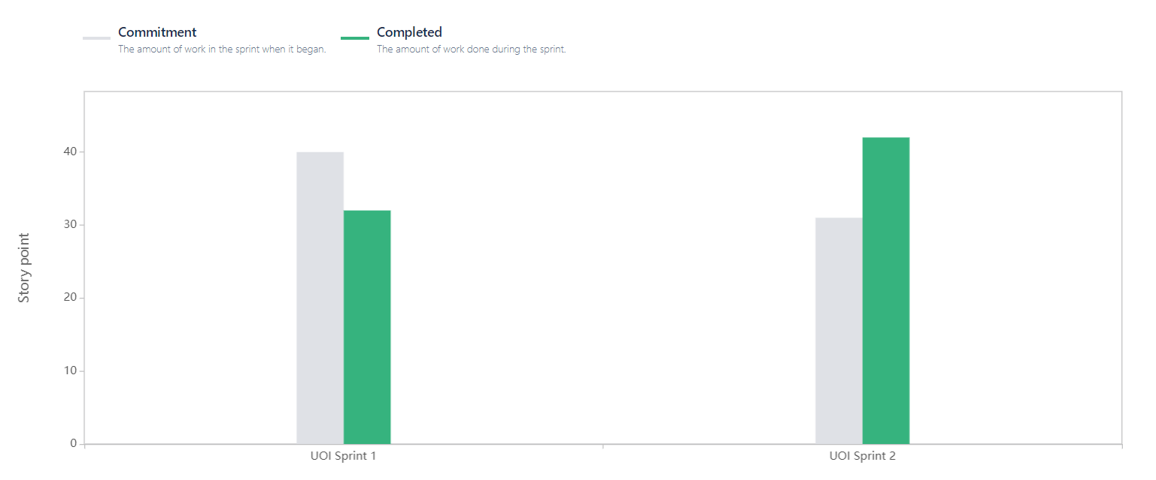
Velocity report
The completed narrative bar may be seen tumbling because the required story points were not finished in the first sprint. The following sprint's plot points were determined after taking this into consideration. Two extra stories from the product backlog are added to the current spring since the allocated story points were finished before the sprint end data, and the difference is as a result.

Slide 19
Change management
Recognize early warning signs and act fast
The earlier you face these problems in the project’s lifecycle, the more options you have to resolve them.
Find out what’s gone wrong
Don’t rush into a fix without first identifying why. Without taking the time to understand the root cause of the problem, any proposed solution will be a shot in the dark.
Revisit the original plan
Don’t forget why you’re doing the project in the first place. Review the original business case and check in from time to time to verify that it’s still valid

Slide 20
Change management
Review your resources.
When scheduling issues occur, it’s easy (and common practice) to simply throw extra bodies at the chaotic project and grow the team. But this rarely yields a great result.
Talk to your clients
None of us likes to share our woes with our clients, but if the relationship is sound, your client will work with you to find a solution. Get a dialogue going and develop a workable plan

Slide 21
THANK YOU

